Slide 1

Task - 2

Slide 2
Introduction
The site Zero Bank Of url:http://zero.webappsecurity.com/ is vulnerable to some major extent.
It is a http site of a bank which carries out some of the major works of a bank like online banking, checking account activity and transferring funds.

Slide 3
Vulnerability
Tools Used For VAPT : ZAP
No. of Vulnerabilities Found : 24
In our vulnerability assessment of the domain we have found about 24 vulnerabilities from zap tool ranging from severity of high to some informational category of vulnerabilities.

Slide 4
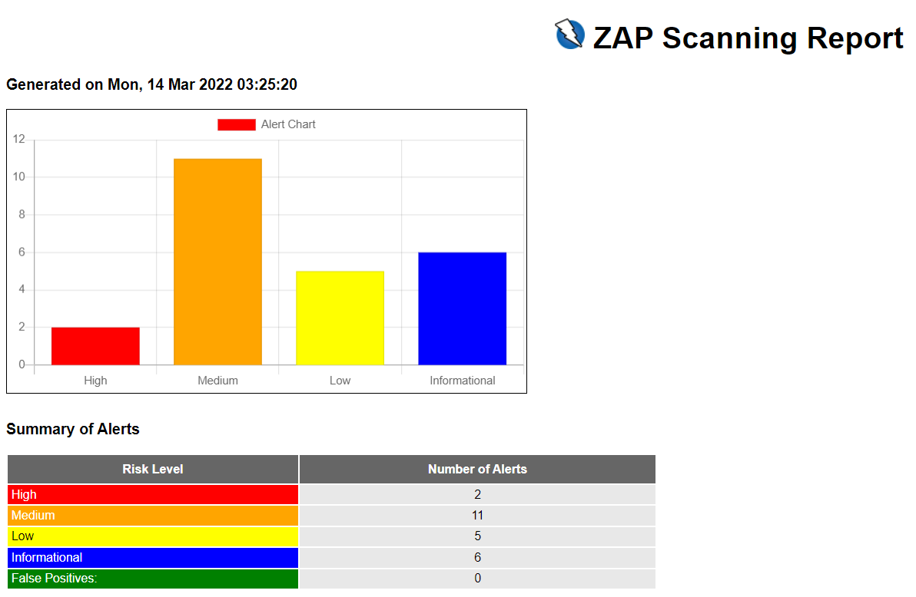
Risk Assessment

Slide 5
High Severity Vulnerability
Name : Anti-CSRF Tokens Check
Instances: 4
Impact : Cross Site Request Forgery
.

Slide 6
Threat
Cross site request forgery
A Cross site request forgery is an attack in which a victim sends an HTTP request to target destination without their knowledge and it is performed with an intent to attack the destination url as a valid user. The use is of using the predictable syntax of URL/form actions in a repeatable way.

Slide 7
Remediation
Do not use GET method for any requests that triggers a state change
Implementation of code free of cross-site scripting issues
Library or framework that does not allow this weakness to exploit the system.

